Slide 1
Bank Marketing Prediction
By
Anand AL
BE-Mechanical Engineer

Slide 2
Objective
Data Exploration
Data Visualization
Data Pre-Processing
Feature Selection
Machine Learning Models
Result – Best Model

Slide 3
Objective - Bank Marketing
Abstract:
The data is related with direct marketing campaigns (phone calls) of a banking institution. The classification goal is to predict that the client will respond or not(Yes or No).
Data Set Information:
The data is related with direct marketing campaigns of a banking institution. The marketing campaigns were based on phone calls. Often, more than one contact to the same client was required, in order to access if the product (response) would be ('yes') or not ('no') subscribed.
To Predict
The customer who will respond to campaign or not

Slide 4
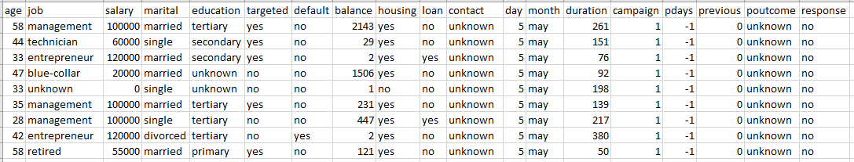
Sample Dataset
Available Variables
Age | Targeted | Loan | Marital | Housing | Month
Job | Default | Contact | Education | Duration | Campaign
Salary | Balance | Day | Pdays | Previous | Poutcome

Slide 5
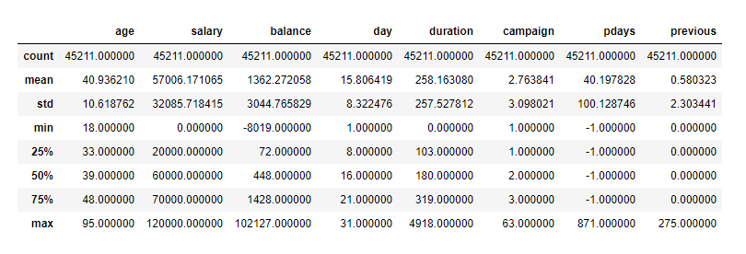
Summary statistics

Slide 6
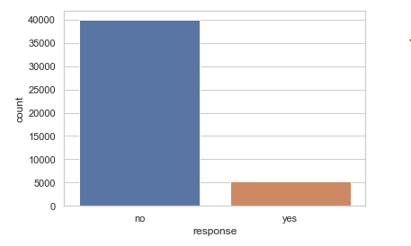
Data Visualization
Cost of Acquiring New Customers ≫ Retaining Old Customers
Total No. Of Customer: 45211
Customer who respond: 5289
Imbalanced Dataset

Slide 7
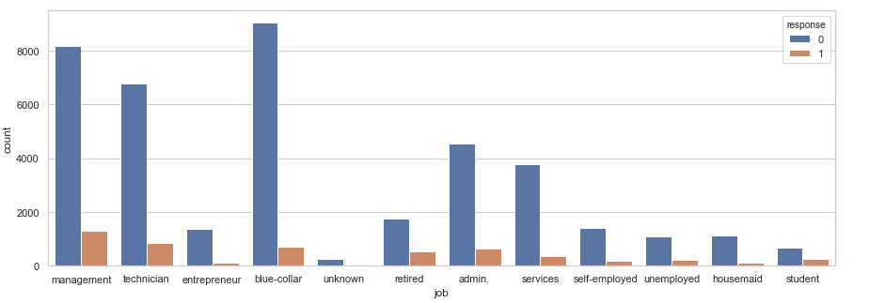
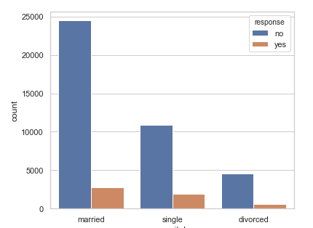
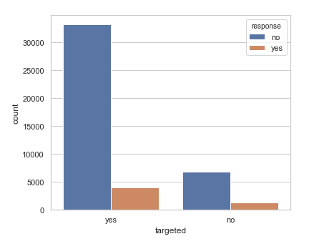
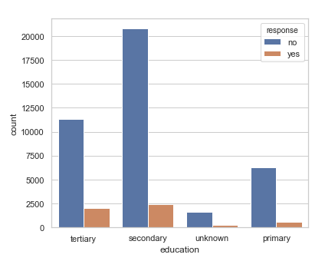
Bar plot for Categorical variables

Slide 8
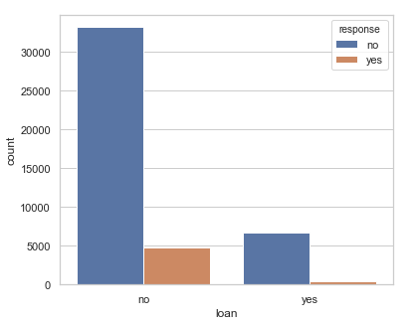
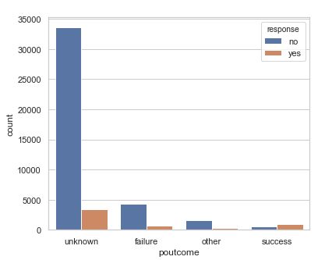
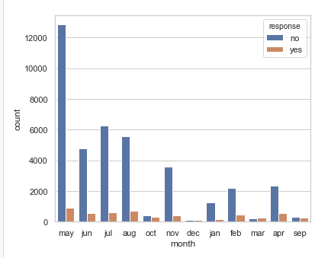
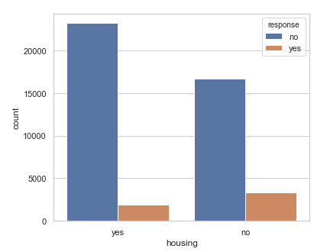

Slide 9
Exploratory Data Analysis
The data for this project represents the results of direct marketing campaigns (phone calls) of banking institution.
The data set has 41,188 instances and 19 features (input variables), which include the respondents’ level of education, social status, month and day, results of a previous marketing campaign, and some macroeconomic indicators.
The predictor variable (“yes”) states the outcome of the marketing campaign - whether the respond (“yes”) or no (“no”).
There is no null data in the given data set
Most of given data is in classification form. So, we are going to get dummy values for them variables

Slide 10
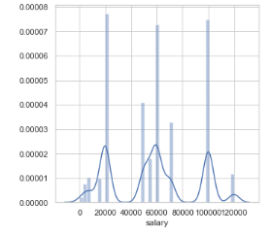
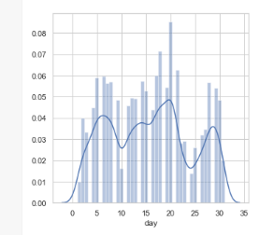
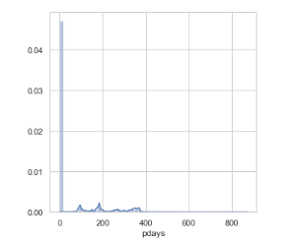
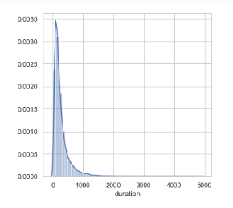
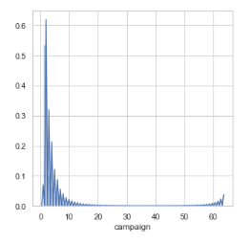
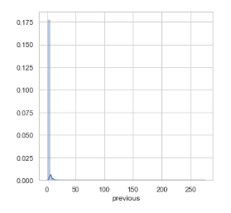
Distribution among numerical data

Slide 11
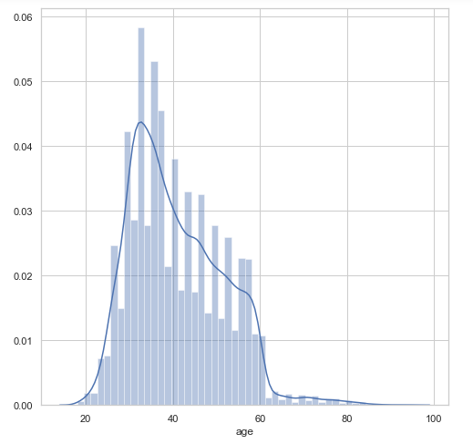
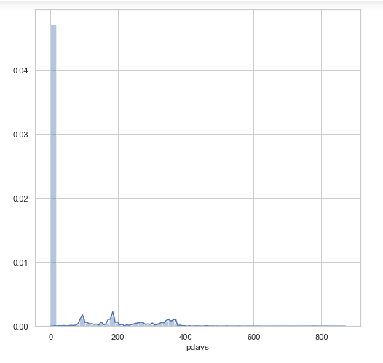
Widely spread data

Slide 12
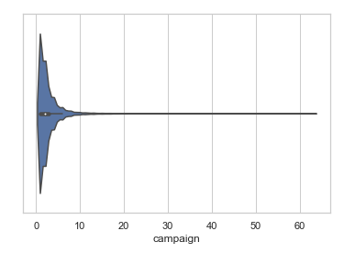
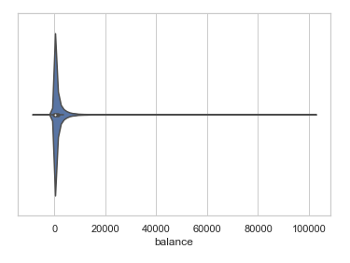
Outliers

Slide 13
Data Pre-Processing
Few observation from exploratory analysis
Widely spread Date
From Data visualization, we can observe that some features where widely spread data.
Data Alteration
So, we are going to group age based on Adult, Mid-Age, old Age.
Outliers:
There are some outliers in campaign & balance features. So, removing outliers.

Slide 14
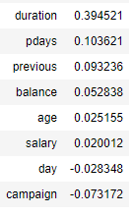
Co-Relations With Response
Duration:
It is highly co-related with response with 40% corr.
Pdays:
It is also co-related 10% with response.
This two variables where highly co-related

Slide 15
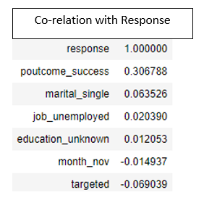
Feature Selection
Important features were identified during model building process for
The Features were ranked using Recursive Feature Elimination Method.
Then Variance Inflation Factor is calculated for selected features.
Then the features with moderate P-Value is selected.
Selected Features:
Post come
Targeted customer
Marital
Month
Education

Slide 16
Machine Learning
Model used:
Logistic Regression
Random Forest
Metrics used:
Precision
Recall
Accuracy
Cross Validation:
K-Fold

Slide 17
Preferred Metrics
Our Target:
To increase customer response
With limited resources.
For this problem:
Precision is important metrics. Which help us to know about successful prediction model.
In this problem the model with High Precision Score & then with High Accuracy is preferred.

Slide 18
Model 1: Logistic Regression
1. Logistic Regression
1.1 From all available features Precision score : 53% Accuracy score : 88% | 1.2 From all selected features Precision score : 64% Accuracy score : 89%
1.3 For K-fold with available features: Average Precision score : 55% Average Accuracy score : 88% | 1.4 For K-fold For all selected features: Average Precision score : 24% Average Accuracy score : 88%
1.5 With selected features & best K-Fold:
Precision score : 69%
Accuracy score : 68%
From all report from various Logistic Regression model. So, I prefer to choose
1.2: Logistic Regression model with selected Features.

Slide 19
Model 2: Random Forest
2. Random Forest
2.1 From all available features Precision score : 69% Accuracy score : 69% | 2.2 From all selected features Precision score : 70% Accuracy score : 70%
2.3 For K-fold with available features: Average Precision score : 37% Average Accuracy score : 84% | 2.4 For K-fold Fro all selected features: Average Precision score : 24% Average Accuracy score : 88%
2.5 With selected features & best K-Fold:
Precision score : 69%
Accuracy score : 69%
From all report from various Random Forest model. So, I prefer to choose
2.2: Random Forest model with selected Features.

Slide 20
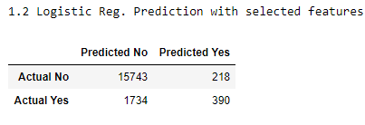
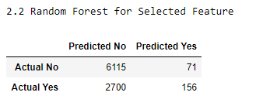
Model Selection
From Logistic Regression
1.2 From all selected features
Precision score : 64%
Accuracy score : 89%
From Random Forest:
2.2 From all selected features
Precision score : 70%
Accuracy score : 70%
From both statement, Both precision score & accuracy score is high in 2.2 - Random Forest with selected features is the best model.

Slide 21
Result
Required Data:
Essential Data that required for this prediction Model:
Post outcome of camp that conducted at that place
Marital status of customer
Job of customer
Education status of customer
Month That the camp will held
Is that customer is Targeted
Observation from Predictions:
Random Forest with selected features is best model among others.
Customer who where single, married has high probability
The targeted customer also has high probability
In the month of May, June, July, Aug has high probability in response

Slide 22
Thank you
External links:
Jupyter notebook: Google Drive
Youtube video :

